Slide 1
LAKE TRAIL
Grade 10 Program
2013/14

Slide 2
Typical High School Timetable
Semester 1 |  | Semester 2
English 10 |  | Social Studies 10
Science 10 |  | Physical Education 10
Math 10 |  |  | Planning 10
Elective 1 |  | Elective 2

Slide 3
Semestered
Student Driven Timetable
Limited Course Offers
Limited Course Space
32/34 Grade 10 credits

Slide 4
Lake Trail Grade 10 Program
Monday | Tuesday | Wednesday | Thursday | Friday
PE 10 | Advisory Community Leadership Study Block Elective | PE 10 | Internship | PE 10
Math 10 |  | Humanities 10 |  | Science 10
Science 10 |  | Humanities 10 |  | Math 10
Humanities 10 |  | Science 10 |  | Humanities 10
Humanities 10 |  | Math 10 |  | Humanities 10

Slide 5
Linear
Personalized Timetable
Interdisciplinary Projects
Resume Building
34 + Credits

Slide 6
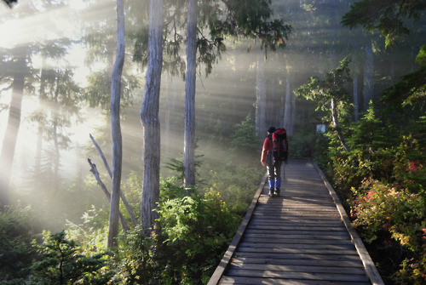
Trips
Start of the year trip - September 2013
(Mt. Washington Nordic Lodge)
Objectives: Teambuilding, hiking, and group brainstorming about class-wide community project.

Slide 7
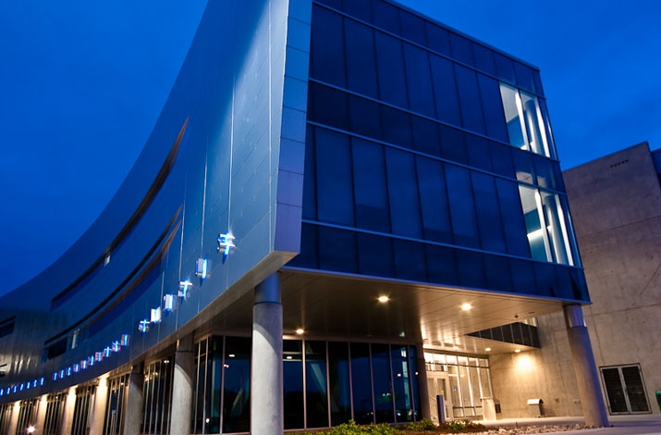
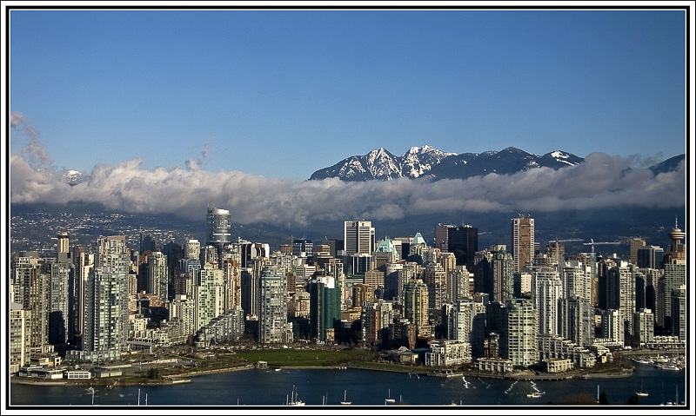
Post Secondary Trip
Visit BCIT, Emily Carr, SFU, UBC for sights set on post-secondary options.

Slide 8


Advisory
You would each have an advisory teacher to help you with your internship placements and co-create with you electives.
Advisors will visit your worksite, help you solve work and school related issues, coach and encourage you.

Slide 9
Community Leadership
Leadership opportunities will focus on the larger community in the Comox Valley.
Continue Lake Trail’s work with the Soup Kitchen.
One class action project that is decided and agreed upon by the group.

Slide 10
Electives
Electives at Vanier include Choir or Band (either before or after school – 4 credits)
Co-Creating Electives - much of this will depend on your internship placement as well as your personal interests and passions.
Ultimately, it will be collaborative effort. Advisory teachers will be able to bridge resources at the school, as well as instructional resources (readings, videos, learning kits).

Slide 11








Electives

