Slide 1
Describe your role in leading a Professional Learning Community which focuses on
supporting students in the acquisition of 21st Century skills.
How will you assist parents in support of their children and what will be some measurements of your success?

Slide 2


Slide 3
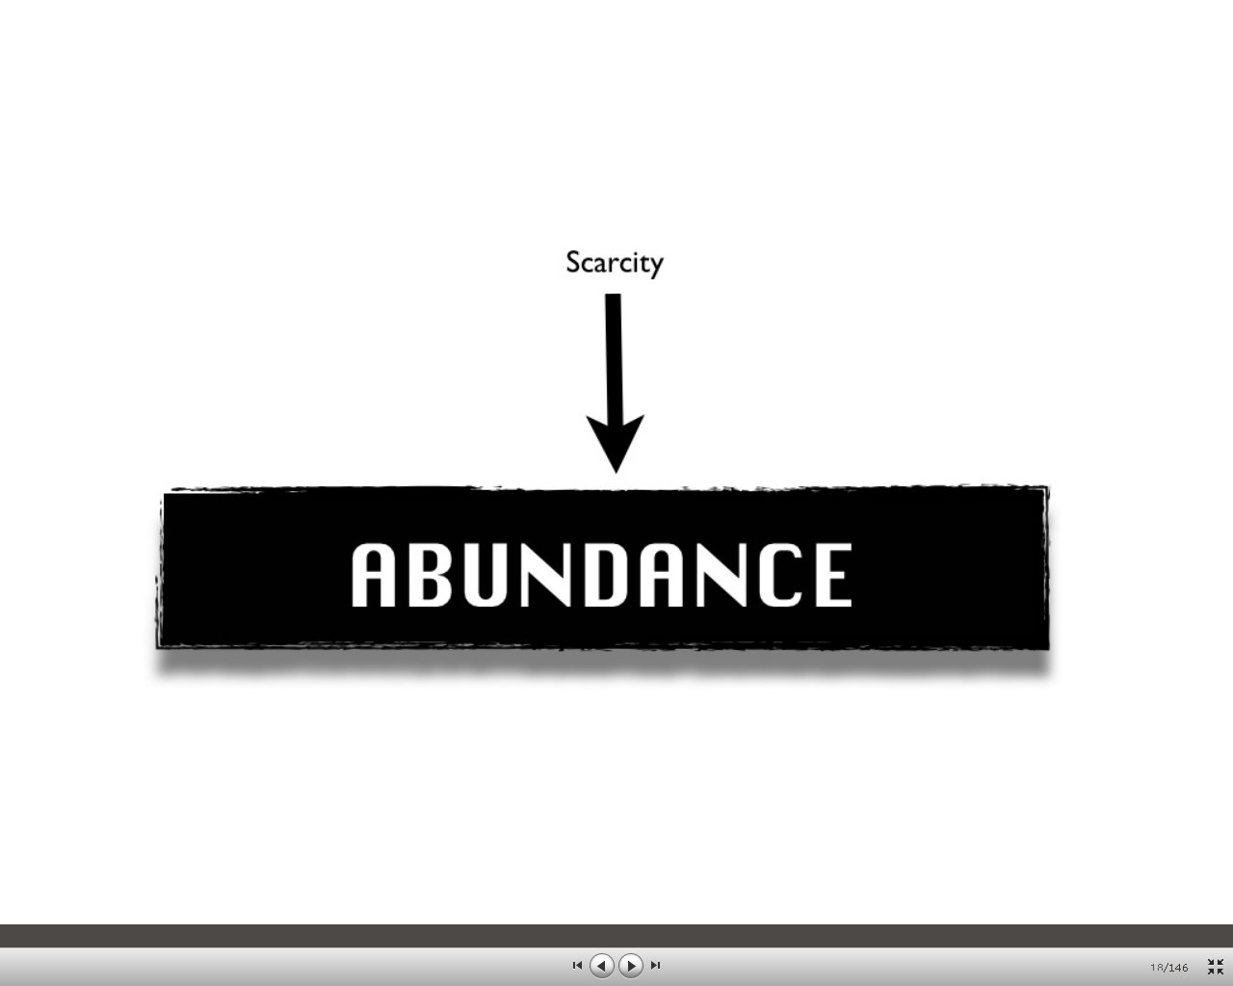


Slide 4
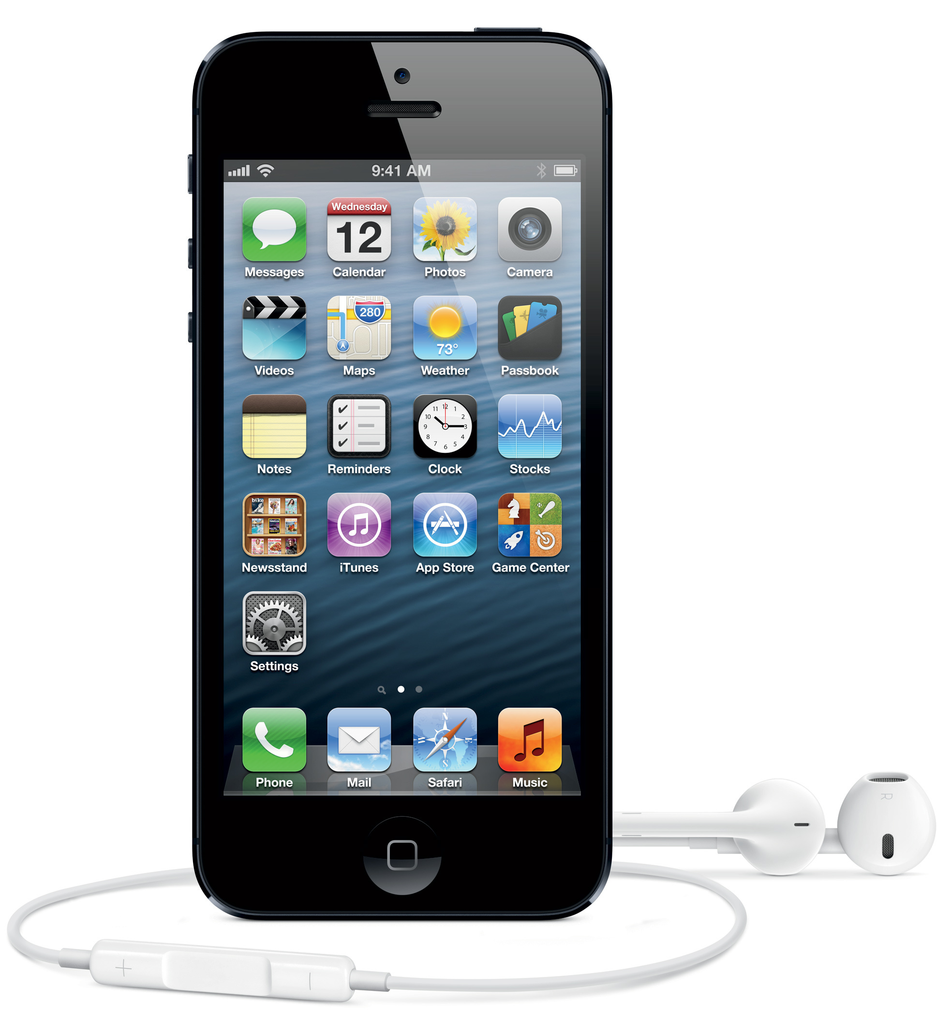
Information at Our Fingertips…

Slide 5
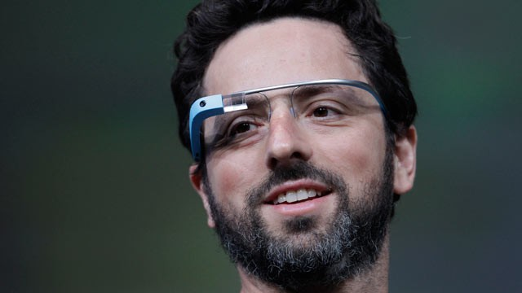
Or closer….What’s Next?

Slide 6
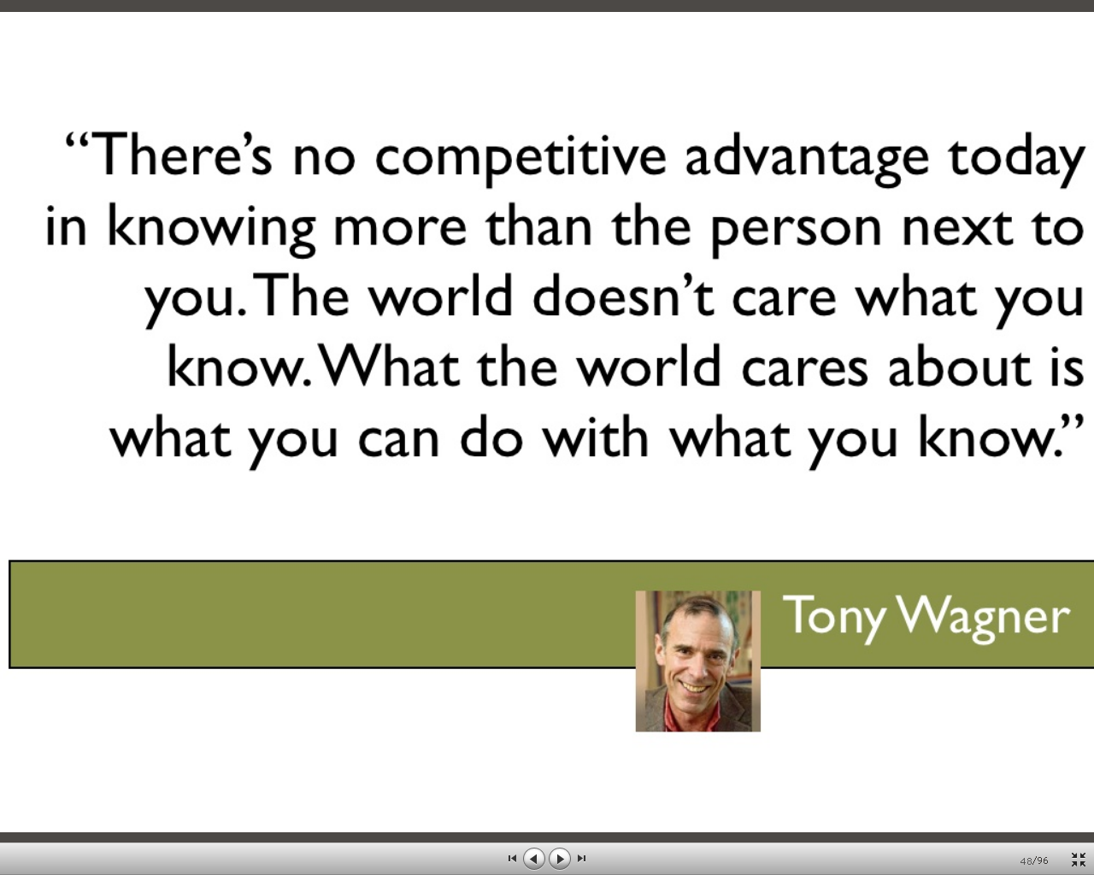



Slide 7
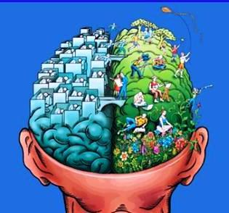
21st Century Skills –The 7 C’s
Communication, Critical thinking, Collaboration, Creativity, Cross-cultural understandings, Career and learning self reliance, Caring for personal health and planet earth

Slide 8

Ministry of Education Draft Document Defining Cross-Curricular Competencies
There are three cross-curricular competencies, each with a number of sub-domains:
Thinking Competency
Critical thinking
Creative thinking
Reflective thinking
Personal and Social Competency
Positive personal and cultural identity
Personal awareness and responsibility
Social awareness and responsibility
Communication Competency
Language and symbols
Digital literacy
On the District Committee (3 provincially) to help define the Communication Competencies for the Ministry

Slide 9
Implementation of these Competencies
learning that is student-initiated, self-directed, inquiry-based, and interdisciplinary
Formative Years (K–5): This phase focuses on forming the knowledge, understanding, and skills for further learning. There is a strong emphasis on literacy, numeracy, and cross-curricular competencies.
Middle Years (6–9/10): This phase offers more student choice to allow students to explore areas of passion. Students have opportunities to apply the strong foundational skills developed in the formative years to inquiries and project-based learning experiences that link their learning to the wider community.

Slide 10

School District 71 District Achievement Contract
Goal One: Personalized Learning:
By 2013, each student will have a personalized learning plan developed in
collaboration between home and school.
In 2014, all students complete a personal learning plan and an individual record of achievement of foundation skills and competencies is maintained henceforth.
By 2023, all students will graduate from high school with purpose, dignity and options, having completed their plan.

Slide 11
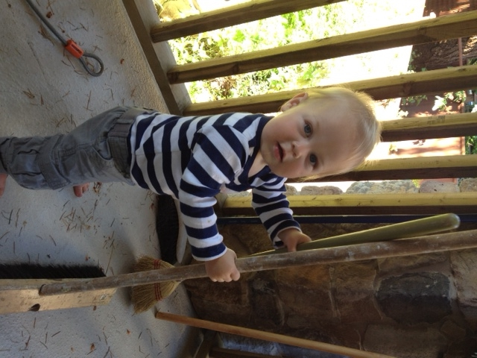
GRAD
2030

Slide 12
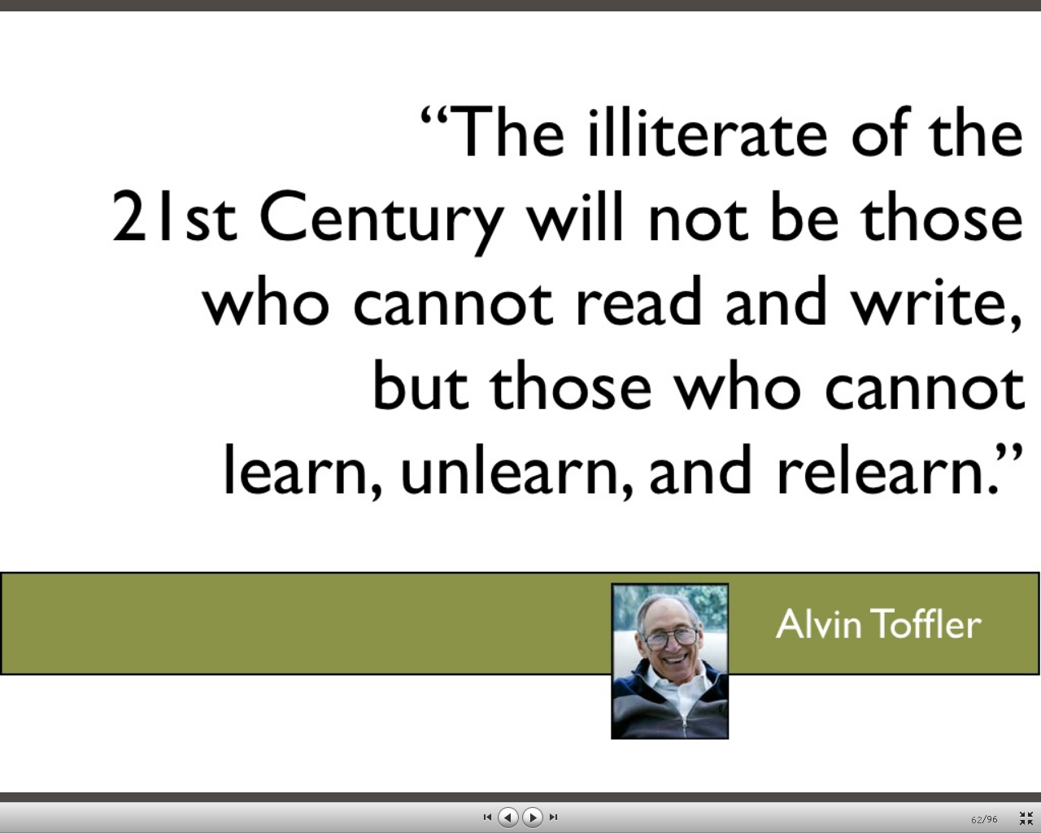

Slide 13



Slide 14
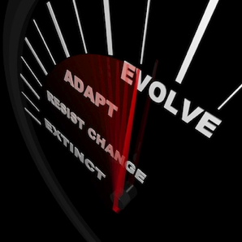

Slide 15
We need to become 21st Century Learners ourselves as educators, focussing on professional learning that is teacher-initiated, self-directed, inquiry-based, interdisciplinary, collaborative and reflective

Slide 16
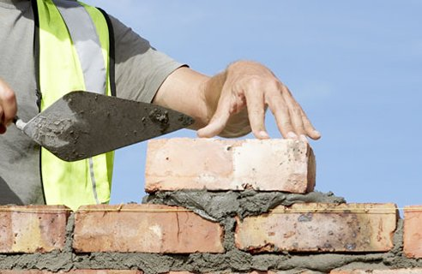
Professional Learning Communities
As a district wide PLC community. It is our belief that in the movement towards a more 21st Century personalized learning, educators and para-professional staff will need time to work together with school leaders as innovative instructional strategies and authentic assessment practices and creativity combine to embed engaged learning opportunities for our students. We are certain that by
honouring the expectations for enhanced learning with collaboration time, we will be more successful in enhancing learning for our students – and we will learn and grow ourselves.
PLC is the mortar, holding it all together and providing the foundation for this change.

Slide 17

PLC Critical Questions of Learning
1. What is it we expect them to learn? Be able to do etc.
2. How will we know when they have learned it?
3. How do we respond if they don’t learn?
4. How do we respond when they already know it?
We focus on student learning, not testing

Slide 18
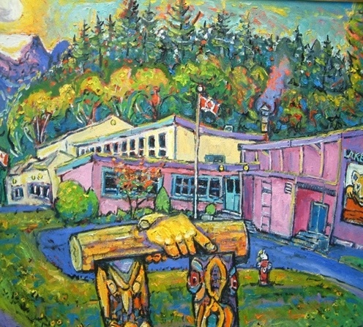
Changes at Lake Trail

Slide 19

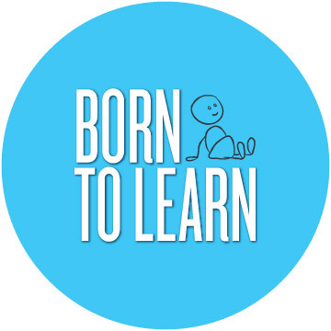
“We are born to learn, not born to be taught”. www.born-to-learn.org

Slide 20
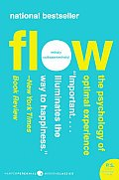
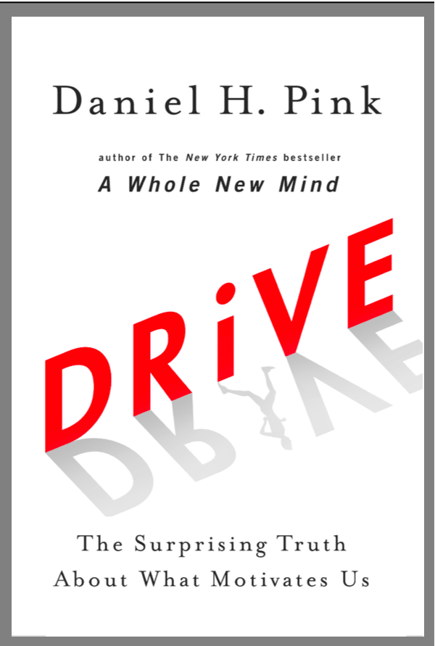


Slide 21
PLC Products
Genetics Debates
Resilience Cafe
Examining Assessment Practices
21st Century Learning Classes
Online Newspaper and job applications
Class Blogs
First Nations Carving Project
Student Blogs
Virus Day
Inquiry

Slide 22
PLC Results
Measuring Engagement
-video interviews with kids
-referrals to the office
-attendance
-retention rates
-school based grades 75-80% of our kids are on the honor roll
-parent attendance at events
-common assessments
DMA, DART, FSA, New Tools developed in PLC that accurately reflect the achievement towards 21st Century Skills and Competencies
Ministry Satisfaction Surveys

Slide 23
2013 BC Ministry of Education Student and Parent Satisfaction Surveys
At school, do you have opportunities to work on things you are interested in as part of your coursework?
Lake Trail 31%
District 24%
Are you aware of the school goals for improving student learning?
Lake Trail 53%
District 45%
At school, do you have opportunities to work together on projects with your classmates?
Lake Trail 54%
District 47%
Do you feel welcome at your school?
Lake Trail 73%
District 70%

Slide 24
How will you assist parents in support of their children?

Slide 25
Parent Communication
  Getting parents to school events, showcases and celebrations of their child’s learning
  Using Social Media to communicate with parents, posting assignments on blogs and showcasing student learning, e-portfolios
  Online access to student work assessment and completion - Engrade

Slide 26
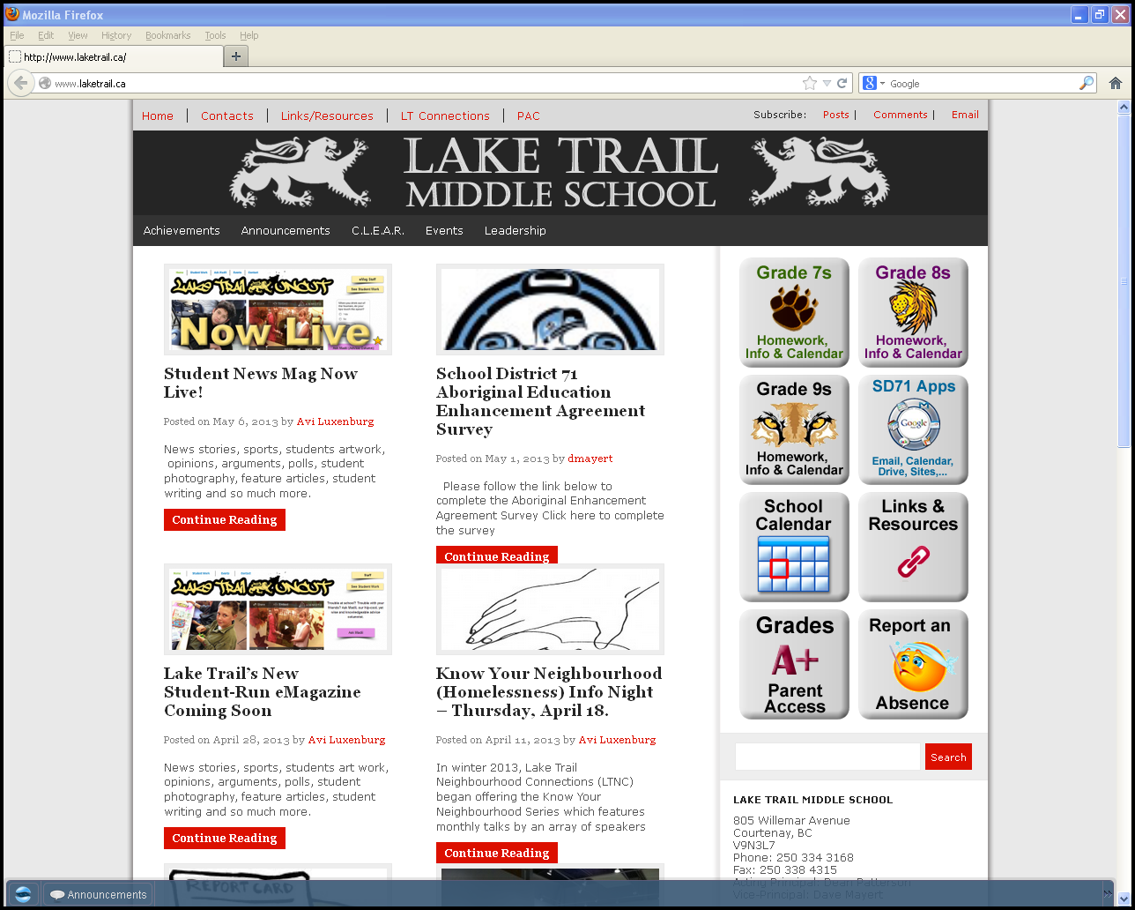

Slide 27
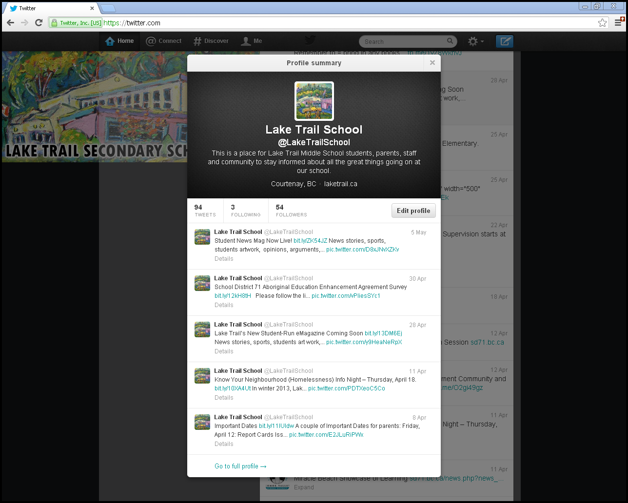

Slide 28
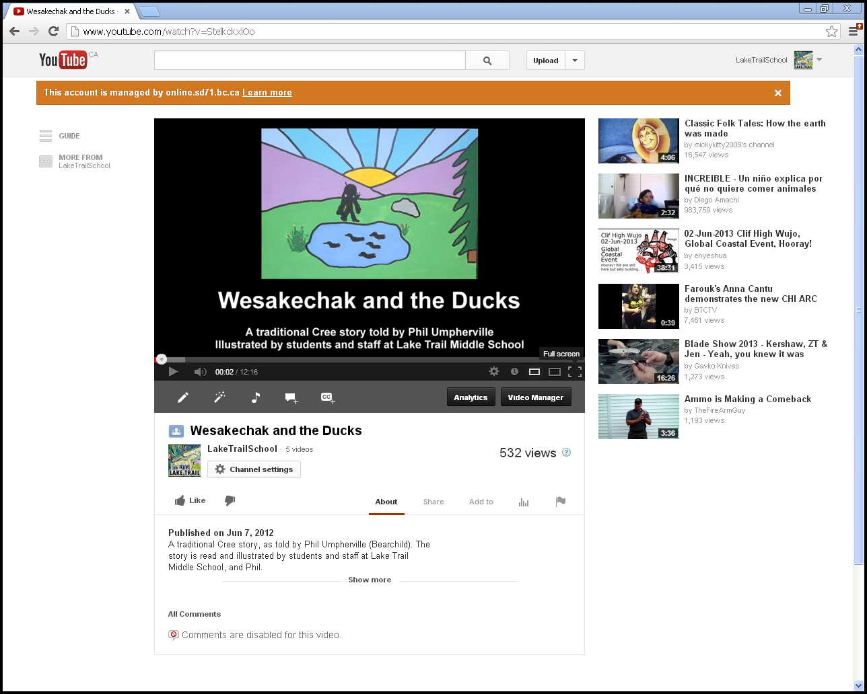

Slide 29
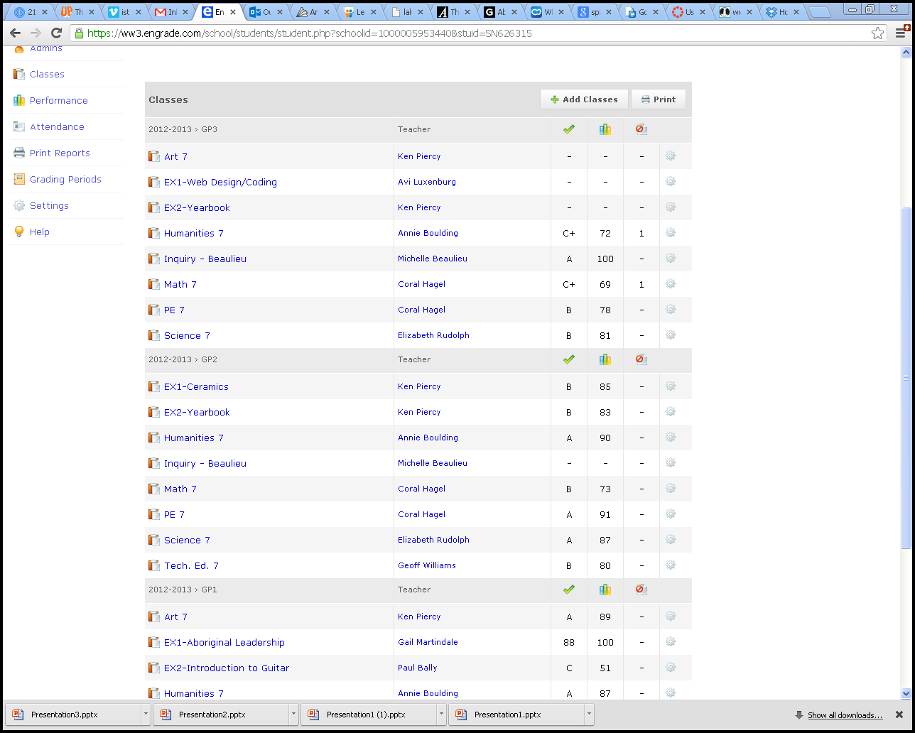

Slide 30
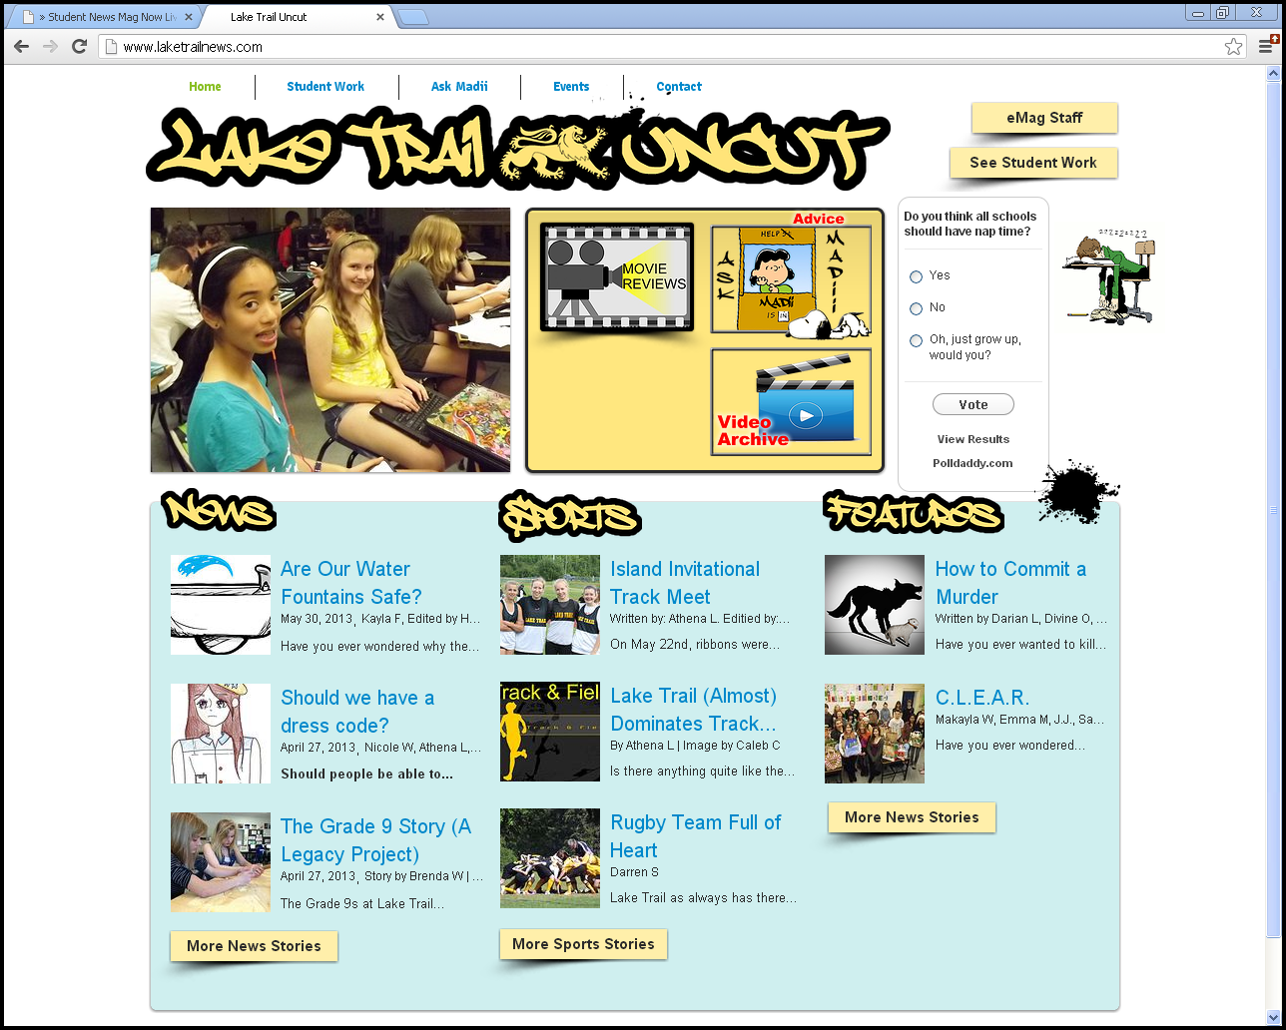

Slide 31
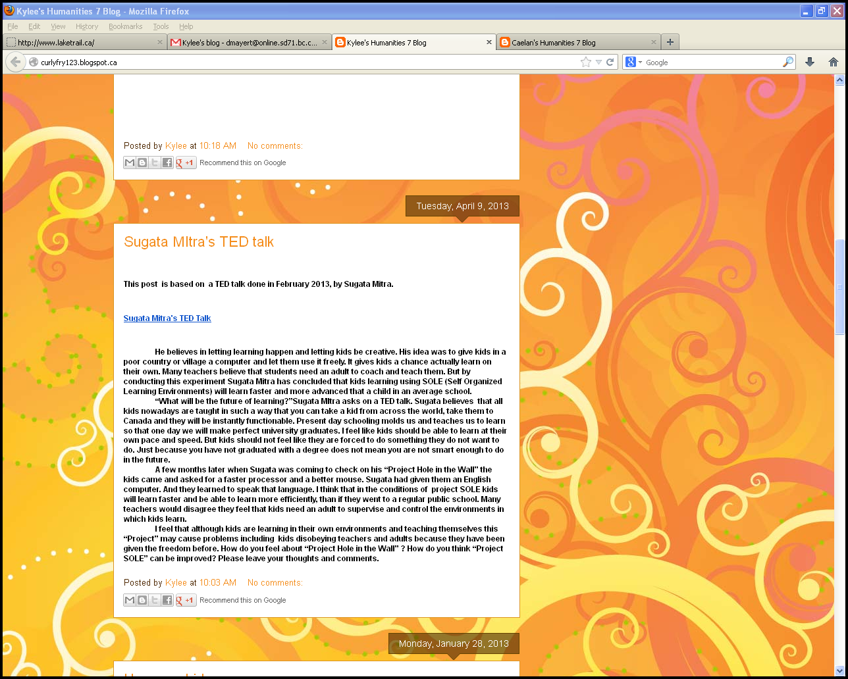

Slide 32
2013 BC Ministry of Education Student and Parent Satisfaction Surveys
Do your teachers help you with your schoolwork when you need it?
51%
Do your parents help you with your learning?
47%
Do you like what you are learning at school?
27%

Slide 33
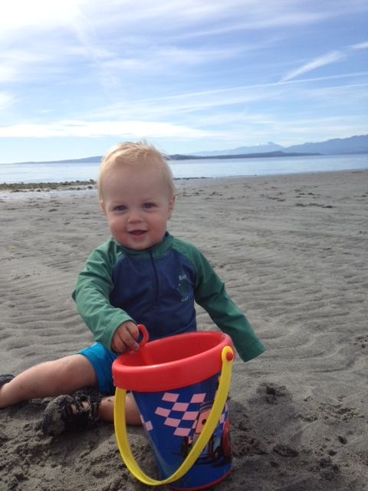
By 2013, Each student will have a personalized learning plan developed in collaboration between home and school. Parent Teacher interviews are no longer one way or one off. PLC is time to develop.
In 2014, all students complete a personal learning plan and an individual record of achievement of foundation skills and competencies is maintained henceforth. PLC is the place to develop how we assess these skills and competencies.

Slide 34
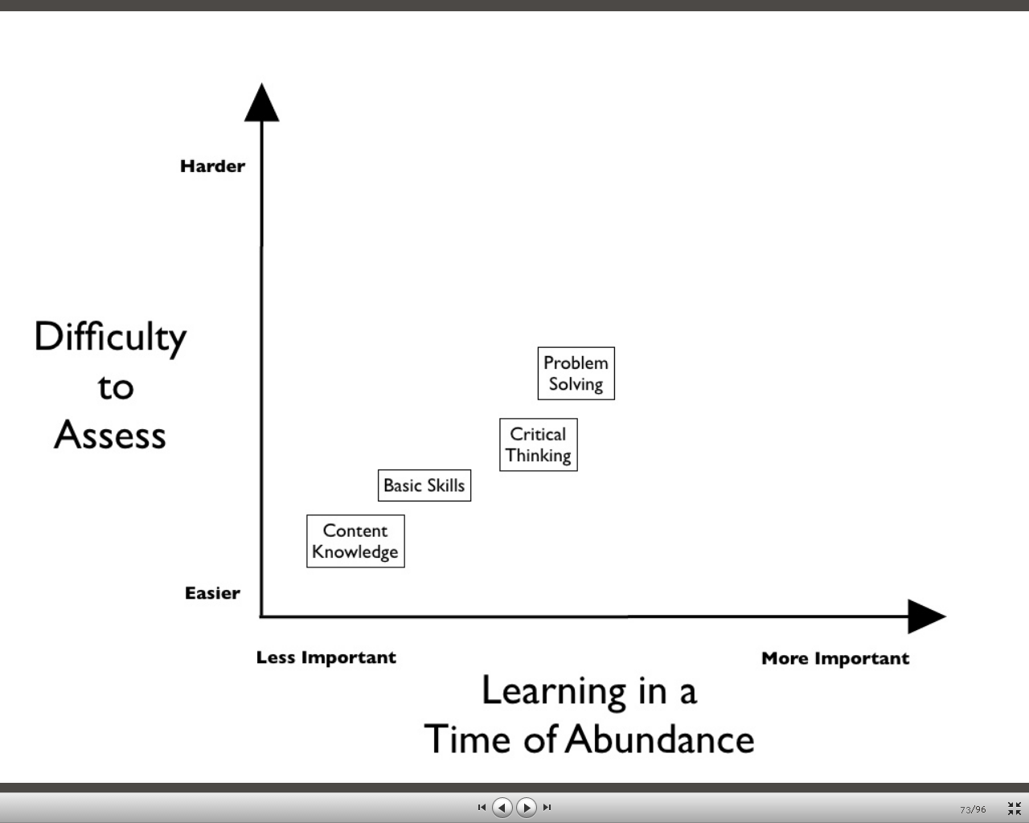

Slide 35
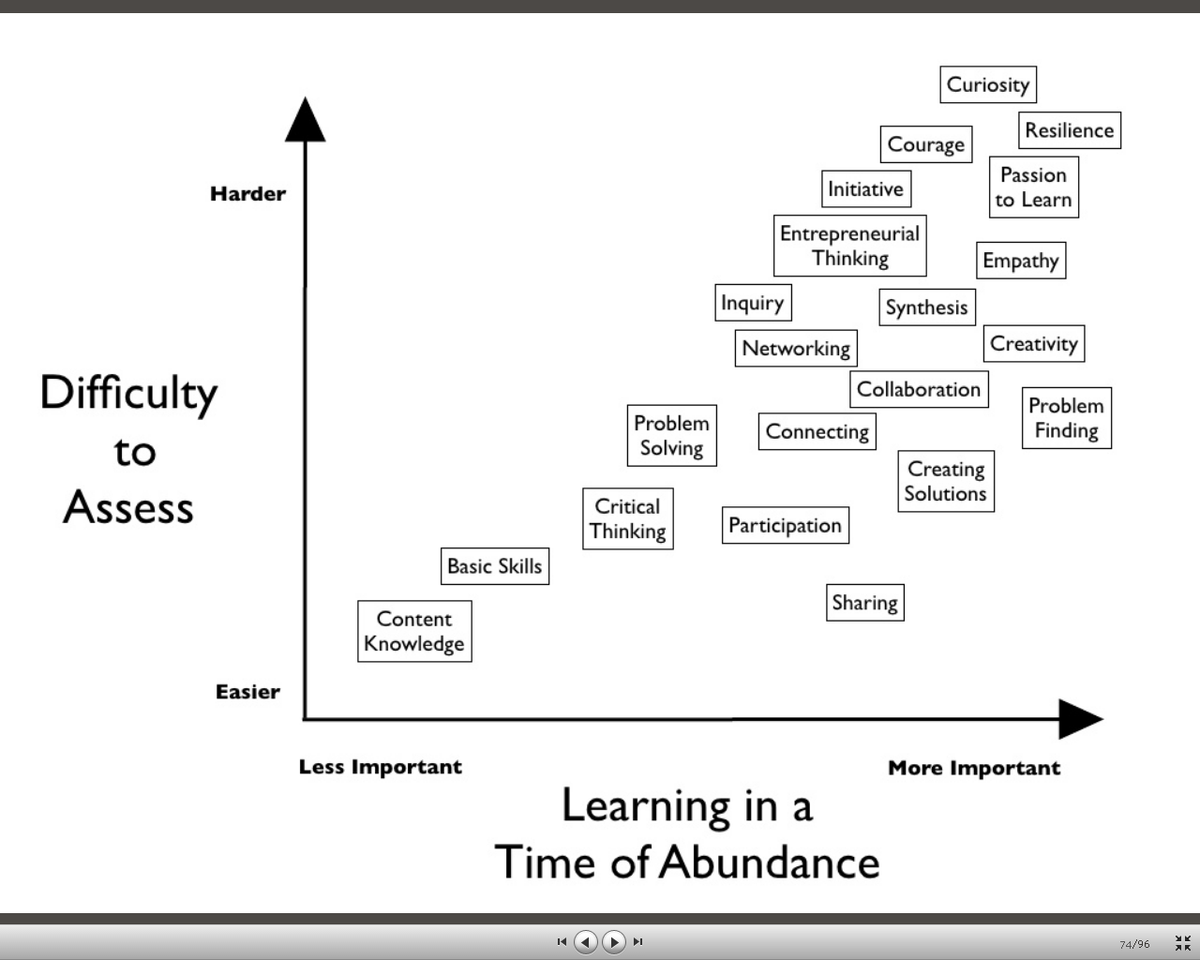

Slide 36
Describe your role in leading a Professional Learning Community which focuses on supporting students in the acquisition of 21st Century skills.
Facilitator, enabler, cheerleader, supporter, team member, creator of a safe risk taking environment, innovator, mostly a learner -“Do it” model it

